Slide 1
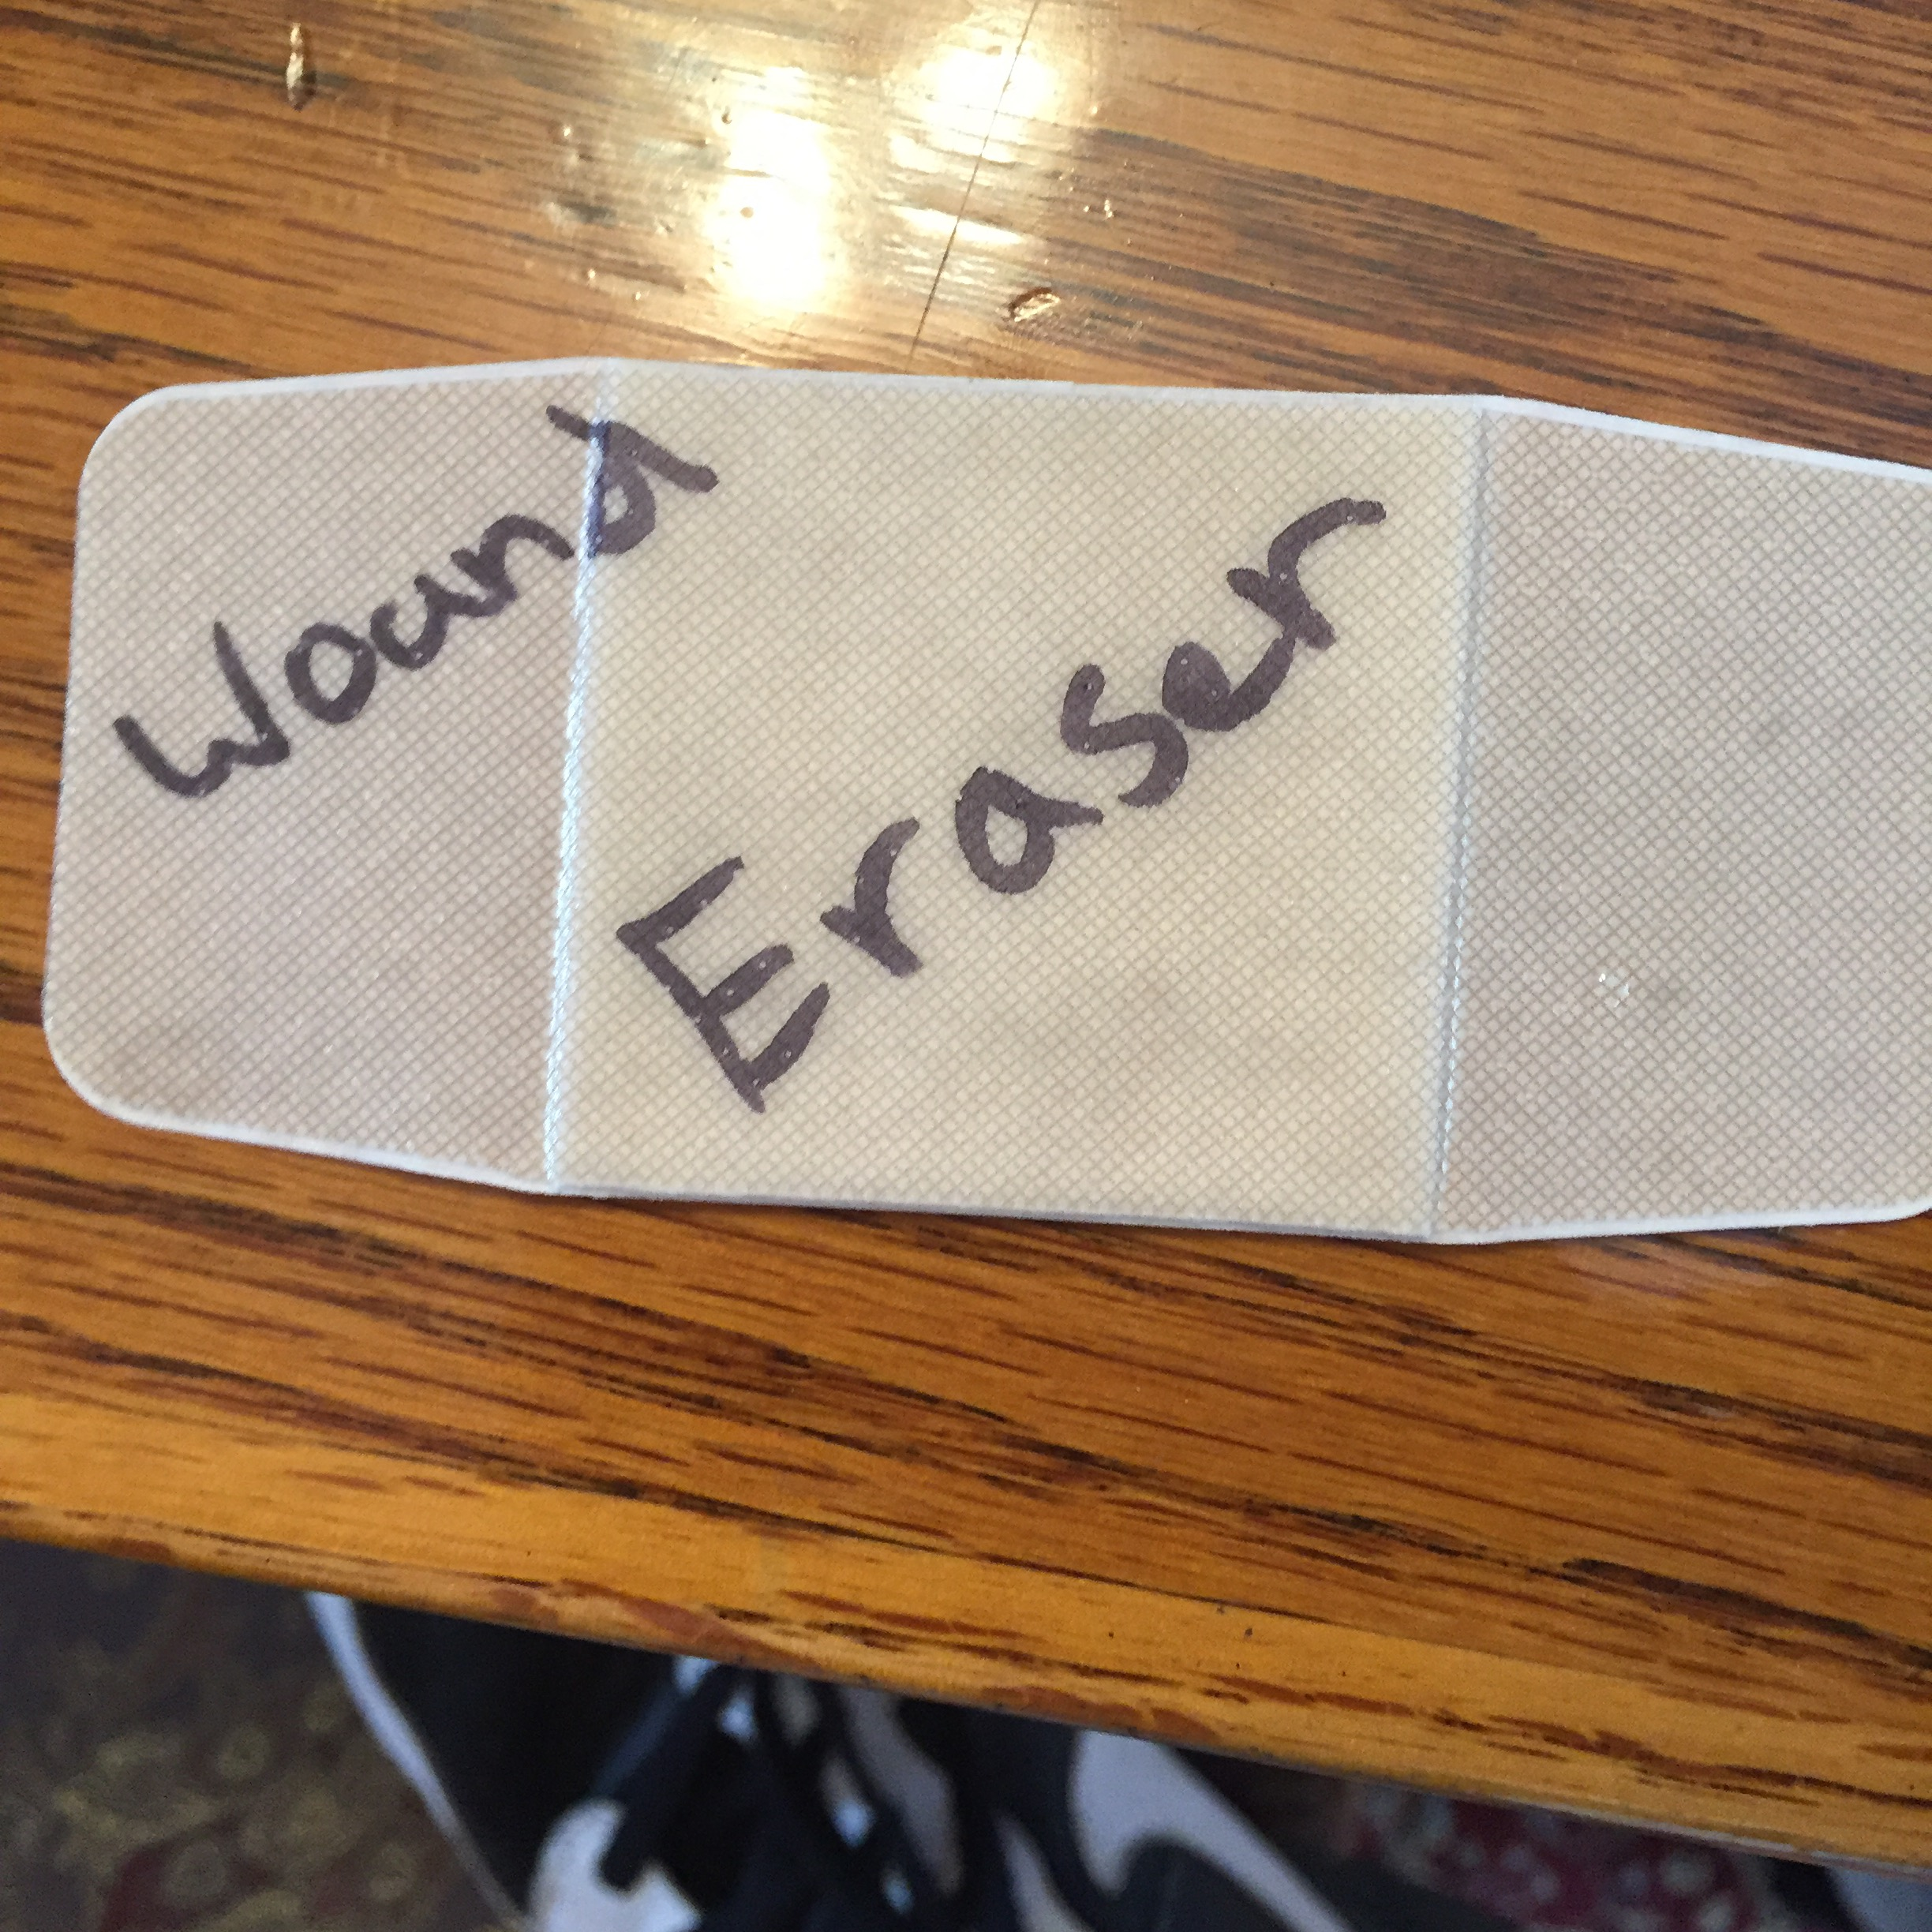
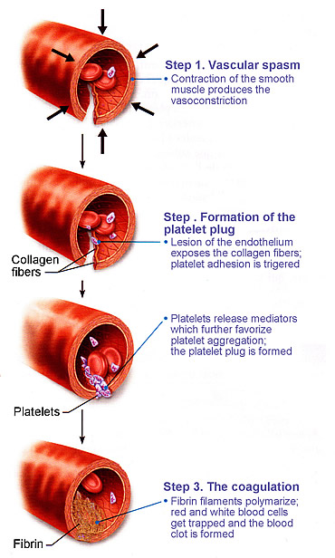
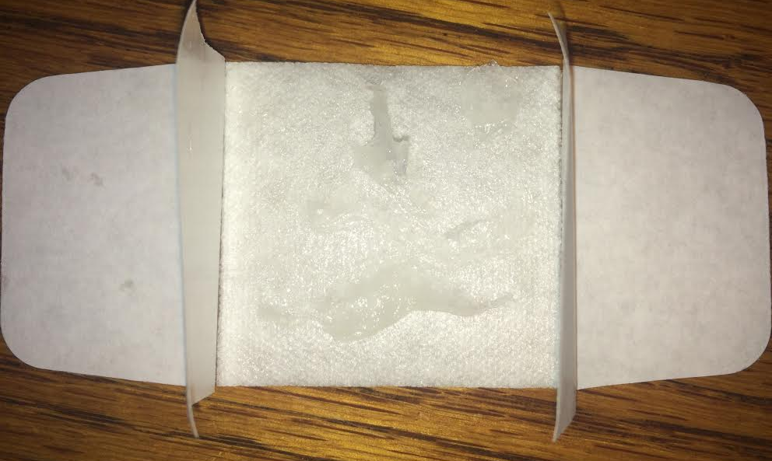
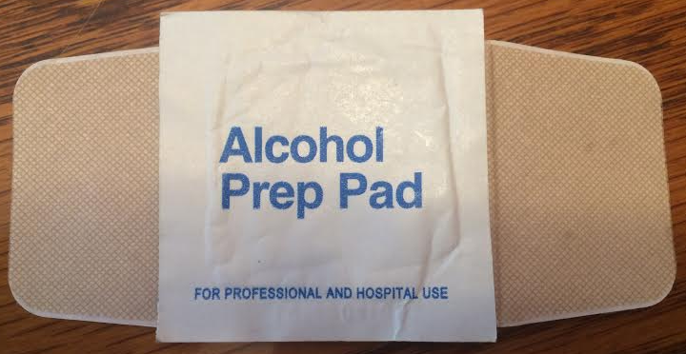
Wound Eraser
Alameda Community Learning Center Team: Bio Boyz: ACLC B
Drake Hayes, Rudi Skowronski, Alfonso Haro, Griffen Vojvoda, and Guillermo Ruiz
Problem and Solution:
Testing and Comparison to Past Alternatives:
Technical Challenges:
History and Past Alternatives:
There are currently no biomedical gels that stop bleeding in a non-surgical setting. Bio-Boyz have created a plant based gel applied onto a sticky bandage that stops bleeding for everyone, including people with Thrombocytopenia (A disease that results in low blood platelet count).
The project shall be tested by having similar incisions on meat samples with two sets of trials. In the first trial a shallow 1.5 inch long incision on top of the forearm and record the amount of time it would take to clot. We would then do the same thing with with a patient that has Thrombocytopenia and record the amount of time it takes them to heal the clot. Using this information we would make the same cut on a new subject with Thrombocytopenia and use the Wound Eraser. We would compare the time for a clot to form with the gel against that of the subjects without normal platelet counts and the subjects with Thrombocytopenia.
We would test the collagen in the petri dish with Thrombocytopenia blood and compare the platelet density near the collagen and away from the collagen. We would also time its effectiveness as explained above.
We want to reduce clotting time for people a normal amount of blood platelets as well. This is the baseline, if the Wound Eraser gel takes more time to clot than a cut on a normal person the gel would be ineffective. If it takes the same amount of time or less time to clot than it takes a healthy person, the gel would be considered effective. Time relative to the amount of time it takes for a healthy person’s blood to clot is the standard.
To record the success of the gel, our team would measure milliliters of blood lost before the wound seals and time in seconds before the wound stopped bleeding.
The design originates from Veti-gel which is a product used primarily to stop traumatic bleeding for animals. The gel was launched in 2015, and is a plant derived gel that stops bleeding by forming a mesh that seals an open wound during surgery. It is manufactured by Suneris Inc, an American Biotechnology company, which is looking towards launching the gel available for human use as early as this year. Currently the gel is exclusively used in surgeries, but the creators are planning on making a military and emergency medicine version of the gel soon. The form for the repurposed gel is not public information.
Before Veti-gel and Wound Eraser, past alternatives to traumatic bleeding include pressure and compression bandages. Both of which are effective for healthy patients with small cuts, however they become less effective as the wound size grows, and is especially ineffective for patients with blood plasma diseases such as Thrombocytopenia.
Due to the fact that the polymers used in this project are natural, a possible limitation of this device is the gel perishing. If this problem develops, our team has another limitation that requires further research is how the gel interacts with the blood vessels and other bodily systems after the gel has sealed the wound and how it might affect the body after the gel is applied.
Solution & Sketches:
Our product, the Wound Eraser addresses small wounds and cuts with plant based polymers, cellulose, collagen, and artificial platelets. Cellulose is found within the cell wall of plants, it will provide structure for blood platelets. Collagen attracts stray platelets from the surrounding blood plasma, which binds together and forms the clots that are necessary to seal the wound. The artificial platelets will help seal the wound, they will be especially helpful for those who suffer from Thrombocytopenia. Previously, a minor cut to someone suffering from Thrombocytopenia could send to the hospital, we hope this bandage, if properly used, will replace that need.
References:
ScienceDaily. ScienceDaily. Web. 30 Mar. 2016.
Bertram, James P., Cicely A. Williams, Rebecca Robinson, Steven S. Segal, Nolan T. Flynn, and Erin B. Lavik. "Synthetic Platelets: Nanotechnology to Halt Bleeding." Science Translational Medicine. U.S. National Library of Medicine. Web. 30 Mar. 2016.
"Breaking News: New Products Squelch Bleeding, Saving Lives A... : Emergency Medicine News." LWW. Web. 30 Mar. 2016.
"College Student Joe Landolina Creates Healing Gel; How Does Veti-Gel Work? [VIDEO]." Medical Daily. 19 Mar. 2013. Web. 30 Mar. 2016.
Grady, Christine. "Payment of Clinical Research Subjects." Journal of Clinical Investigation. American Society for Clinical Investigation. Web. 30 Mar. 2016.
"Hemophilia." Causes. Web. 30 Mar. 2016.
"Materials360 Online." Synthetic Platelets Could Aid In Blood Clotting and Bleeding Cessation -. Web. 30 Mar. 2016.
Orlova, N. A., S. V. Kovnir, I. I. Vorobiev, A. G. Gabibov, and A. I. Vorobiev. "Blood Clotting Factor VIII: From Evolution to Therapy." Acta Naturae. A.I. Gordeyev. Web. 30 Mar. 2016.
"Thrombocytopenia (low Platelet Count)." - Mayo Clinic. Web. 30 Mar. 2016.
"U.S. Food and Drug Administration." Vitagel™ Surgical Hemostat. Web. 30 Mar. 2016.
"Veti-Gel: A Magic Formula? - Geek Synergy." Geek Synergy. 09 Sept. 2014. Web. 30 Mar. 2016.
Ethical Concerns:
As with any medication or product produced from a biological background, an ethical analysis is necessary. The gel is plant based, meaning no animals would be harmed or used in its creation (except for testing). Unlike Wound Eraser’s competitors, Vitagel and Veti-gel, Wound Eraser would be sold in smaller doses, and be made more accessible so that everyone can use it at a lower price and in more situations than just surgery. A consequence of including artificial platelets is that the product wouldn’t be safe in large doses. Large doses increase the risk of blood clots leading to clotted veins and heart attacks.
Moving into testing the Wound Eraser, after doing extensive tests on animals the team would slowly work towards testing the gel on humans. At this point there is no getting around that testing the gel would harm humans. All of the participants would need to thoroughly understand the experiment in it’s entirety. Informed consent is our number one priority when choosing test subjects. We would not include any information about compensation for the human subjects until the subjects have informed consent. After they participate in the first sitting they would be informed that they will receive 200 dollars at the end of the 60 day test period. We purposefully do not mention the 200 dollars until consent is given because that could coerce their decision to participate. Once testing is ready to begin testing, the tests would be held in a hospital just in case something goes wrong. We would test the patient by making differing size cuts on their forearm. Then the bandage would be applied. After the bandage is applied, a day later we would recommend the person switch to conventional bandages. 30 and 60 day check ins would be held to see how the wounds are healing. After the conclusion of the test the patient would receive 200 dollars for their time helping us.
Criteria | Weight | Vitagel | Veti-gel | Bio Boys
Effective for all users | 20% | 0 | 0 | 1
Cost | 20% | -1 | 1 | 1
Effectiveness for all wound types | 20% | 1 | 1 | 0
Aesthetically Pleasing | 10% | 0 | 0 | 1
Availability | 10% | 1 | 1 | 1
Ease of Use | 10% | 1 | 1 | 1
Ethical Issues | 10% | -1 | 1 | 1
Total | 100% | .1 | .7 | .9
The wound is made
The Wound Eraser with its gel.
The human body begins sealing the wound, the increased collagen attracts more blood platelets
Veti-gel
Veti-gel is a product used primarily to stop traumatic bleeding. It is a plant derived gel that stops bleeding by forming a mesh within the extracellular matrix that seals the open wound. It is manufactured by Suneris Inc, an American Biotechnology company, which is looking towards launching the gel in humans as early as this year. The gel is exclusively used in surgeries, but the creators are planning on making a military and emergency medicine version of the gel. One 30 mg syringe costs 30 dollars.
Vitagel
Vitagel is a Surgical Hemostat that stops bleeding during surgery. It cannot be used in blood vessels and is made from bovine collagen and bovine thrombin. One 20 mg/mL costs 484 dollars.
Cellulose helps form a wall for the blood to stop clotting. It combines all of the platelets together.
*After the wound is made if cleaning is required you could use the bandage
The wound is sealed
Acknowledgements
ASUC Sponsored, ADA Accessible, ESC FiComm
A special thanks to Andrew Hild and UC Berkeley for this opportunity and guiding our team through the process.

