Slide 1
U.S. Coal
by Caroline Harlow, Drake Hayes, & Jackie Culajay

Slide 2
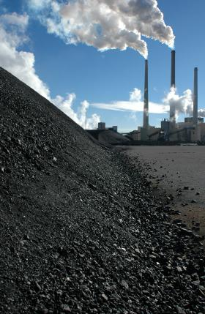
The Significance of Coal In The U.S.
Coal accounts for 39% of US electricity production (2014).
More than 90% of coal mined in the United States is used by the electric power industry.
Coal fired power impacts land use, water pollution, waste management, and air pollution.
Largest Contributor to human caused increase of CO2 in the atmosphere.
Coal produces solid waste products that contain mercury, methane, uranium, thorium, and arsenic.
Estimated to shorten 1,000,000 lives annually worldwide, and 24,000 lives annually in the US.

Slide 3
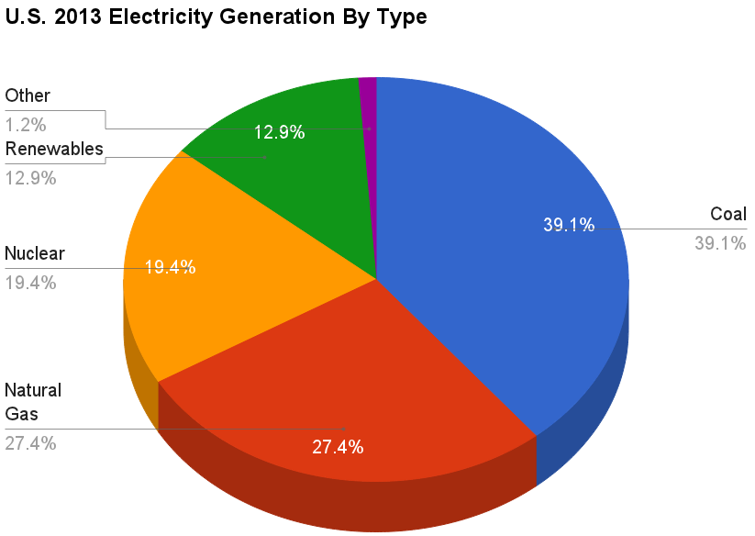
The Significance of Coal In The U.S.

Slide 4
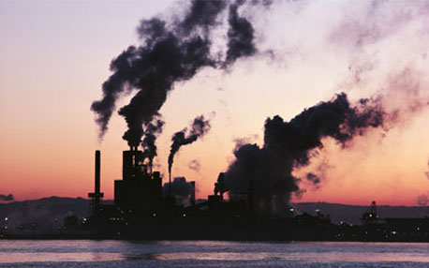
Purpose of Investigation
Largest toxic air releases
44 coal-fired power plants have been classified as hazardous
See how the production, consumption, exportation, and importation of coal has changed.
We wanted to identify whether the United States has made successful efforts to lower the use of coal.

Slide 5
Scientific and Social Concepts/Terms
Pollution
Net exporter
Net importer
Production
Consumption

Slide 6
Data
Year | Years after 1970 | Total US Coal Consumption (Short Tons) | Total US Coal Production (Short Tons) | Production - Consumption (Short Tons)
1973 | 3 | 562583603 | 598568000 | 35984397
1974 | 4 | 558401800 | 610023000 | 51621200
1975 | 5 | 562640432 | 654641000 | 92000568
1976 | 6 | 603789974 | 684913000 | 81123026
1977 | 7 | 625290963 | 697205000 | 71914037
1978 | 8 | 625224827 | 670164000 | 44939173
1979 | 9 | 680524248 | 781134000 | 100609752
1980 | 10 | 702729735 | 829700000 | 126970265
1981 | 11 | 732626833 | 823775000 | 91148167
1982 | 12 | 706910644 | 838112000 | 131201356
1983 | 13 | 736672312 | 782091000 | 45418688
etc. up to 2009

Slide 7
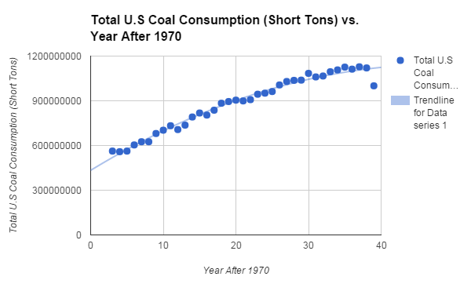
Trendline Equation:
y = -308682x² + 3(10^7) + 7x + 8
Derivative:
y’= 2.9628(10^7) - 617400x
Rate of Change at 2006
2.9628(10^7) -617400(36)=7393600

Slide 8
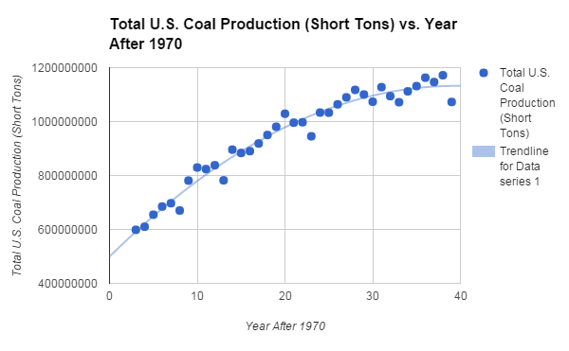
Trend Line Equation:
y=-4.079(10^5)x^2+3.214(20^7)x+4.99(10^8)
Derivative
y’= 32140000 - 815800x
Rate of Change at 2006:
32140000-815800(36)=52771200

Slide 9
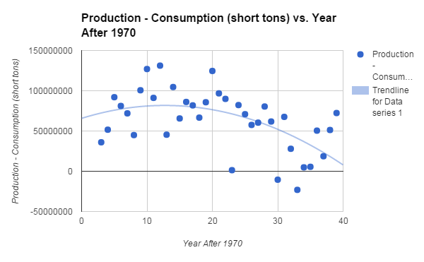
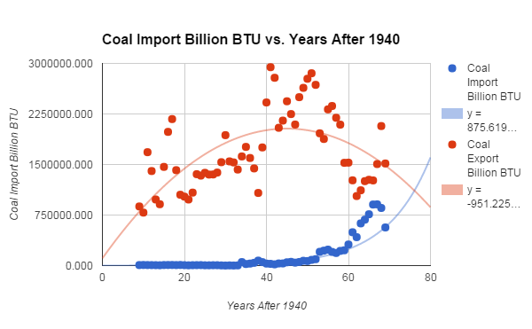
Coal Import
y= -951.225x^2 + 85569.224x + 1.082(10^5)
Coal Export
y= 875.619e^(0.094x)
Trend Line Equation:
y=-99195.002x^2+2.522(10^6)X+6.571(10^7)

Slide 10
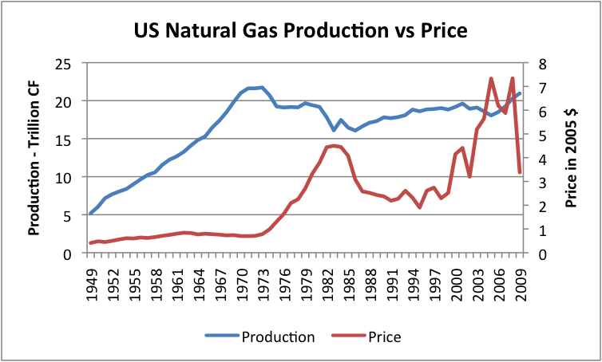
Patterns and Analyses
It is predicted that in 2016, the United States will become a net importer of coal.
In 2014, the United States imported 8.3 million short tons of coal from Colombia.
The U.S. should be a net coal exporter between 2020 and 2030.

Slide 11
Alternatives to Coal Energy
Since coal is a fossil fuel it increases the amount of greenhouse gases in the atmosphere when burned. It is not a sustainable source of energy as we are running out of the resource in America.
Multi Billion dollar oil companies such as British Petroleum and Royal Dutch Shell acknowledge the need for renewable energy, saying by 2050, ⅓ of the world's energy will need to be renewable. Even though scientists disagree with this percentage of renewable energy even the oil companies are acknowledging the problems fossil fuels such as coal are causing. In America coal makes up 39 percent of our current energy use.

Slide 12
Most Popular Renewable Energy Resources
Solar Power:
The technology used to turn the sun’s energy into electricity
Through the use of solar panels and solar farms we can begin to replace a portion of coal energy with solar energy
Only .2% of the United States total energy is from solar energy

Slide 13
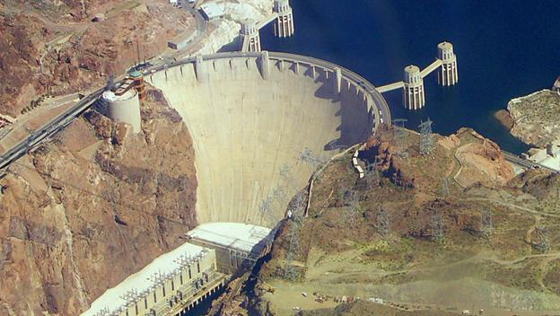
Most Popular Renewable Energy Resources (cont.)
Hydroelectric power:
Source of energy that uses to force of moving water to generate electricity
Makes up 6.5% of the United States electricity needs
The largest hydroelectricity producer in America is the Hoover Dam
It is most used in California, New York, Washington, Oregon, and Alabama

Slide 14
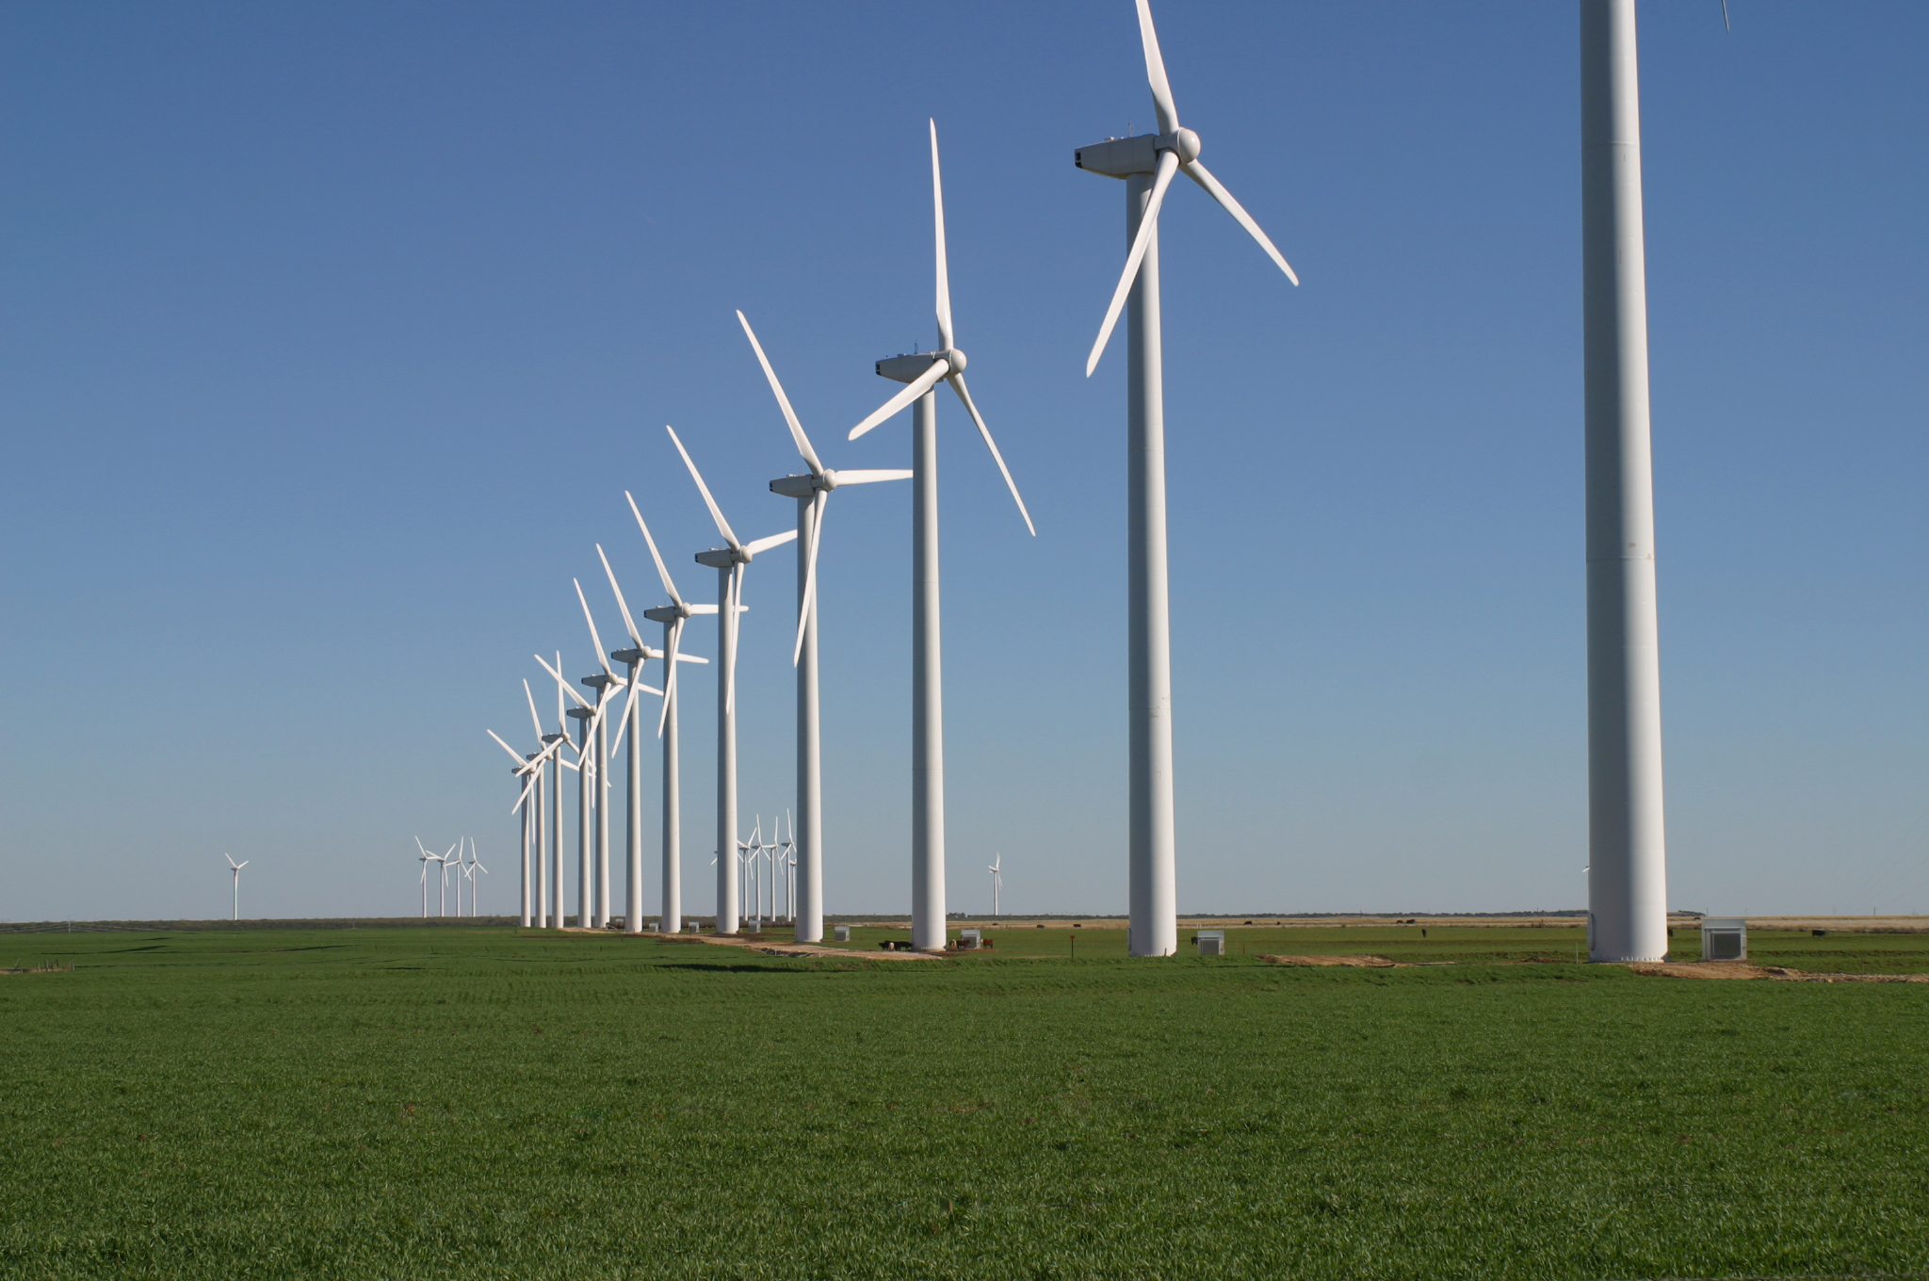
Most Popular Renewable Energy Resources (cont.)
Wind Energy:
Converts energy from wind into electricity
They depend on wind direction and require large amount of money. They make noise and threaten birds.
4.4% of the electricity generated in America is from wind.

Slide 15
Position and Trade Offs
We think that the world needs to begin using sustainable energies instead of coal. because of its negative impact on the environment.
Renewable energies are fighting a fight that
lawmakers are not paying attention to.
This is a consequence of lobbying and
politicians that will not take action against
Global Warming.

Slide 16
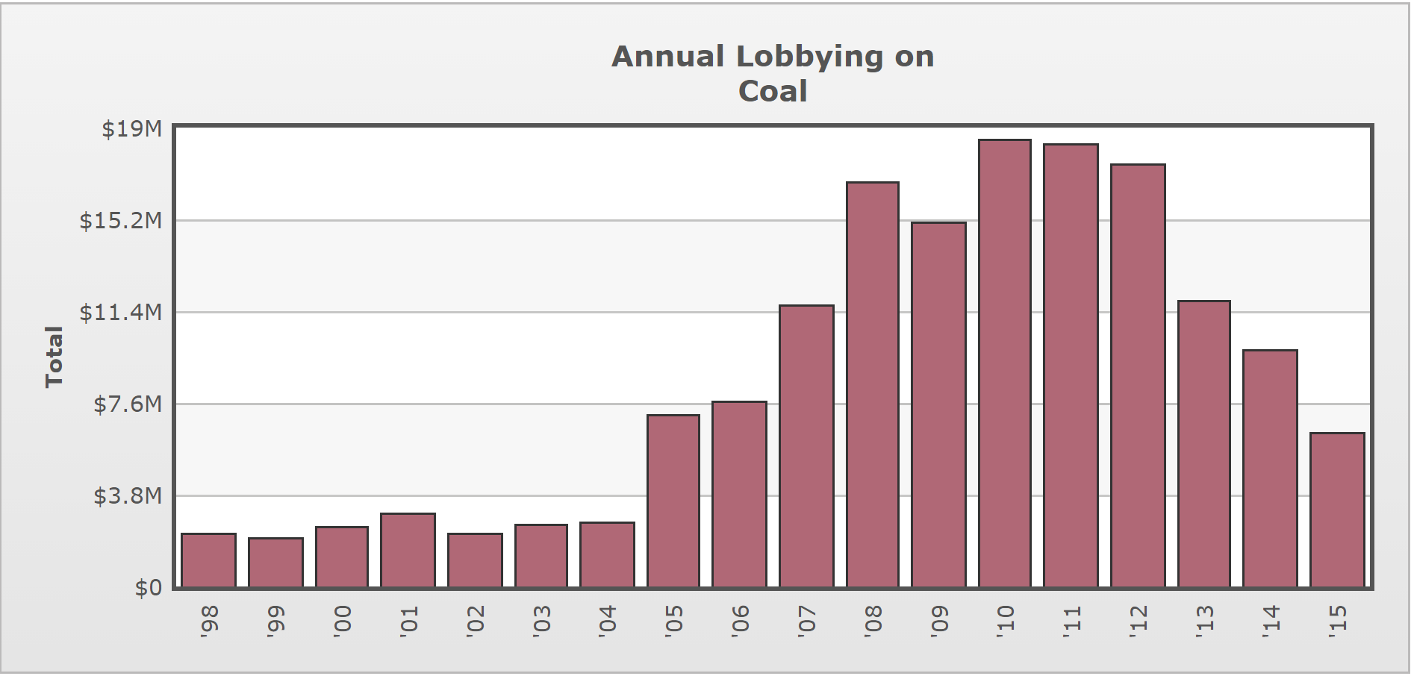
In 2014 the Coal Industry has spent $9,817,063.

Slide 17
cont.
Some politicians don’t need to be persuaded to vote against renewable energies.
Marco Rubio
“I believe the climate is changing because there’s never been a moment where the climate is not changing. The question is, what percentage of that … is due to human activity? … Scientists can’t tell us what impact it would have on reversing these changes.”
Interviewed by Bob Schieffer of “Face the Nation” on April 19th, 2015

Slide 18
Marco Rubio Doesn’t Make Sense
Per Capita, America emits the most Carbon Dioxide into the environment at 16.6 tons.
China emits 7.4 tons per capita
The EU emits 7.3 tons per capita
According to the Netherlands Environmental Protection Agency

Slide 19
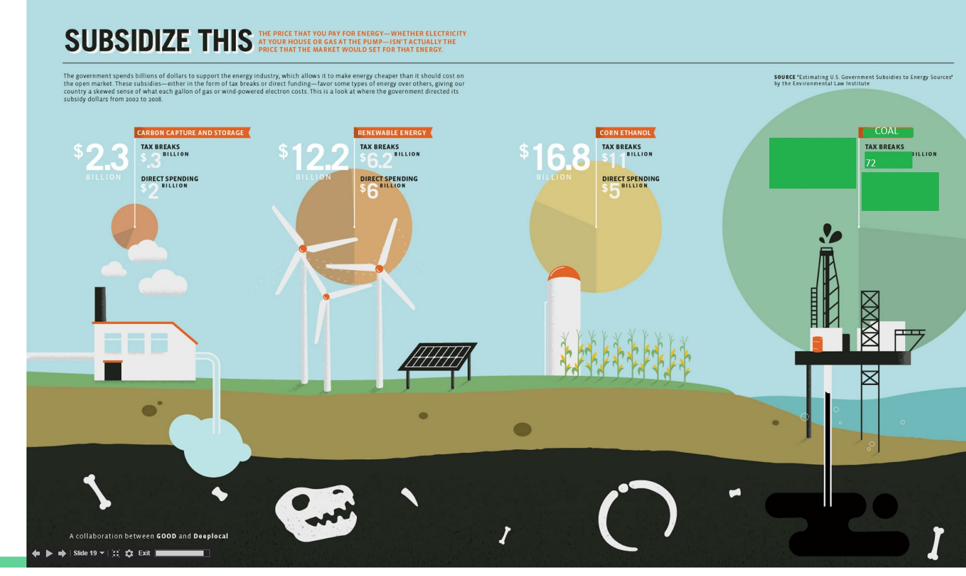

Slide 20
Conclusion
Coal is a fossil fuel that emits greenhouse gases into the atmosphere. In 2016, the United States will become dependent on foreign coal because we have exercised the coal resources in America. We can reduce the impact of coal energy by using renewable energies such as Wind, Solar, and Water. Politicians choose not to accelerate the use of renewable energies because of lobbying and lack of respect for science. As a consequence 72 billion dollars were spent on tax breaks towards the coal industry in 2007. America needs to support renewable energies if we want to promote meaningful change in greenhouse gas emissions in America.

Slide 21
Sources
"Alternative Energy." - Wind, Solar, Hydro and Other Alt Energy Sources for Home Power. N.p., n.d. Web. 03 Nov. 2015. <http://www.altenergy.org/>.
Ahmad, Ghada. "U.S. Coal Between Transition and Sustainability." (n.d.): n. pag. Web. 02 Nov. 2015. <http://www.cggc.duke.edu/pdfs/2013-1-25_Coal_Paper.pdf>.
"Coal Mining in the United States." Wikimedia Foundation. 6 Oct. 2015. Web. 02 Nov. 2015. <http://www.friendsofcoalwest.org/education/coal-facts#.VjkIfberTIU>.
"Comparing Fossil Fuel Subsidies with Renewable Energy." Hippie Magazine. N.p., 06 July 2012. Web. 03 Nov. 2015. <http://hippiemagazine.com/2012/07/06/infographic-renewable-energy-vs-fossil-fuels-comparing-subsidies/>.
"Fast Facts About Coal." Friends of Coal. N.p., n.d. Web. 03 Nov. 2015. <http://www.friendsofcoalwest.org/education/coal-facts#.VjkIfberTIU>.
"Hydroelectric - IER." IER. N.p., n.d. Web. 04 Nov. 2015. <http://instituteforenergyresearch.org/topics/encyclopedia/hydroelectric/>.
Maehlum, Mathias Aarre. "Wind Energy Pros and Cons." Energy Informative. N.p., 23 Mar. 2015. Web. 04 Nov. 2015. <http://energyinformative.org/wind-energy-pros-and-cons/>.
Mufson, Steven. "Power Plant Rejected Over Carbon Dioxide For First Time." Washington Post. The Washington Post, 19 Oct. 2007. Web. 04 Nov. 2015. <http://www.washingtonpost.com/wp-dyn/content/article/2007/10/18/AR2007101802452.html>.
Rubio, Marco. Interviewed by Bob Schieffer. "Rubio’s Intellectually Hollow Position on Climate Change." Rubio's Intellectually
Hollow Position on Climate Change. The Washington Post, 19 Apr. 2015. Web. 15 Oct. 2015.
“U.S. Energy Imports and Exports to Come into Balance.” U.S. Energy Information Administration. EIA, 15 Apr. 2015. Web. 05 Nov. 2015. <http://www.eia.gov/todayinenergy/detail.cfm?id=20812>
"Coal: A Long History of Subsidies." Coal: A Long History of Subsidies. N.p., 2011. Web. 05 Nov. 2015. <http://www.taxpayer.net/library/article/coal-a-long-history-of-subsidies>.
http://edgar.jrc.ec.europa.eu/news_docs/jrc-2014-trends-in-global-co2-emissions-2014-report-93171.pdf

